Slide 1

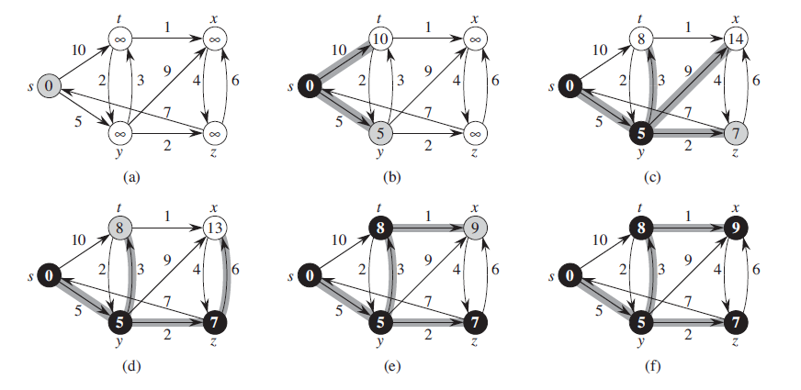
Dijkstra’s Algorithm
Find The Shortest Path
Michael Uftring
Indiana University
I-590 Data Visualization
Fall, 2017
http://www.codebytes.in/2014/08/dijkstras-algorithm-implementation-in.html
Notes:
Dijkstra’s algorithm is not new. It was conceived by computer scientist Edsger Dijkstra in 1956 while working at the Mathematical Center in Amsterdam. It was originally constructed to demonstrate the capabilities of a new computer.

Slide 2
Introduction
What is this project about?
What will be presented?
Notes:
The aim here is to visually present networks and shortest paths through them. I want to utilize what we learned throughout the lectures and Labs in this course, especially what we learned about D3.

Slide 3
Objectives
Purpose
To explore and visualize Dijkstra’s Shortest Path algorithm
Motivation
Mid-term was a data analysis project
I wanted to undertake a dev-type project
Dust off my memory of something I learned in undergrad
Work on something in an area that I have a lot of interest
graph theory, networks, complex systems
Notes:
Having done a data analysis project for the mid-term, I wanted to try a different type of project. This idea came to me while working on the Labs about visualizing networks with D3 – and looking at a subway map to find my way in the city.

Slide 4
Dijkstra’s Algorithm
What is it?
An algorithm for finding the shortest path between nodes in a graph
https://en.wikipedia.org/wiki/Dijkstra%27s_algorithm
Notes:
When Dijkstra conceived this algorithm, his objective was to choose a problem as well as an answer that non-computing people could understand. He designed the algorithm for a transportation map in the Netherlands.

Slide 5
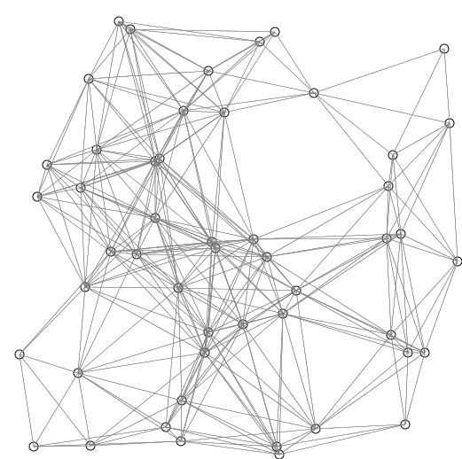
Dijkstra’s Algorithm
How does it work?
picks the unvisited node with the lowest distance
calculates the distance through it to each unvisited neighbor
updates the neighbor's distance if smaller
https://commons.wikimedia.org/w/index.php?curid=54537901
Notes:
How does it work? First: pick the unvisited node with the shortest distance from where we are. Calculate the distance through that node to each unvisited neighbor, and update the neighbor's distance if smaller. And repeat.

Slide 6
Dijkstra’s Algorithm
Why is this interesting and important?
Networks are everywhere
Finding the shortest path in a graph (network) is important in many fields of study
Discovering relationships which may not be readily apparent
Optimization
Notes:
What makes Dijkstra’s algorithm significant – and more generally finding the shortest path – is its extensive utility to graphs, and that it is applicable in every domain where networks and complex systems exist.

Slide 7
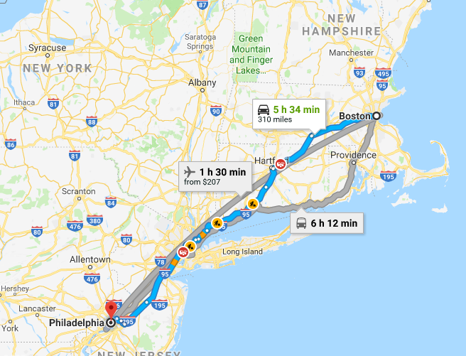
Dijkstra’s Algorithm
Where is this (or related algorithms) used?
Routing computer network traffic
Transportation networks
e.g., roads, trains, airplanes
VLSI design
Exploiting arbitrage opportunities
Notes:
Shortest Path has applicability in many well-known areas. For computer scientists and engineers, one of the first thoughts that may come to mind is routing packets through computer networks. But, there are many more areas that we use this concept every day.

Slide 8
Dijkstra’s Algorithm
Maybe a more accurate description would be: finding the most optimal path
Consider a network with more than one path from the source to the destination
“short” implies distance (perhaps the fewest hops?)
The path with least cost may be longer in terms of hops
The sum total of the edge weights of each hop is less than that of perhaps “shorter” paths
Notes:
Finding the Shortest Path really means finding the Most Optimal Path. In a network, when we want to get from “A” to “B” we are looking at the cost of each path. That lowest cost path may be one hop away or it may be many hops away.

Slide 9
Related Work
Search the Internet for: visualizing dijkstra's algorithm
Google reports “About 86,800 results”
Some are visual explanations of Dijkstra’s algorithm
Some serve specific needs (i.e., gaming)
Just 3 will be showcased here (in the interest of time, and doing justice to the implementers)
Notes:
There is no shortage of examples of visualizing Dijkstra’s algorithm on the Internet. I spent time looking at about 15 different implementations. Three of the best ones – in my opinion – will be showcased based on demonstration of the basics and visual appeal.

Slide 10
David Galles, University of San Francisco
Description:
An animated visualization of Dijkstra’s algorithm for randomly generated graphs
https://www.cs.usfca.edu/~galles/visualization/Dijkstra.html
Notes:
David Galles of the University of San Francisco produced a web application which visualizes the execution on randomly generated graphs.

Slide 11
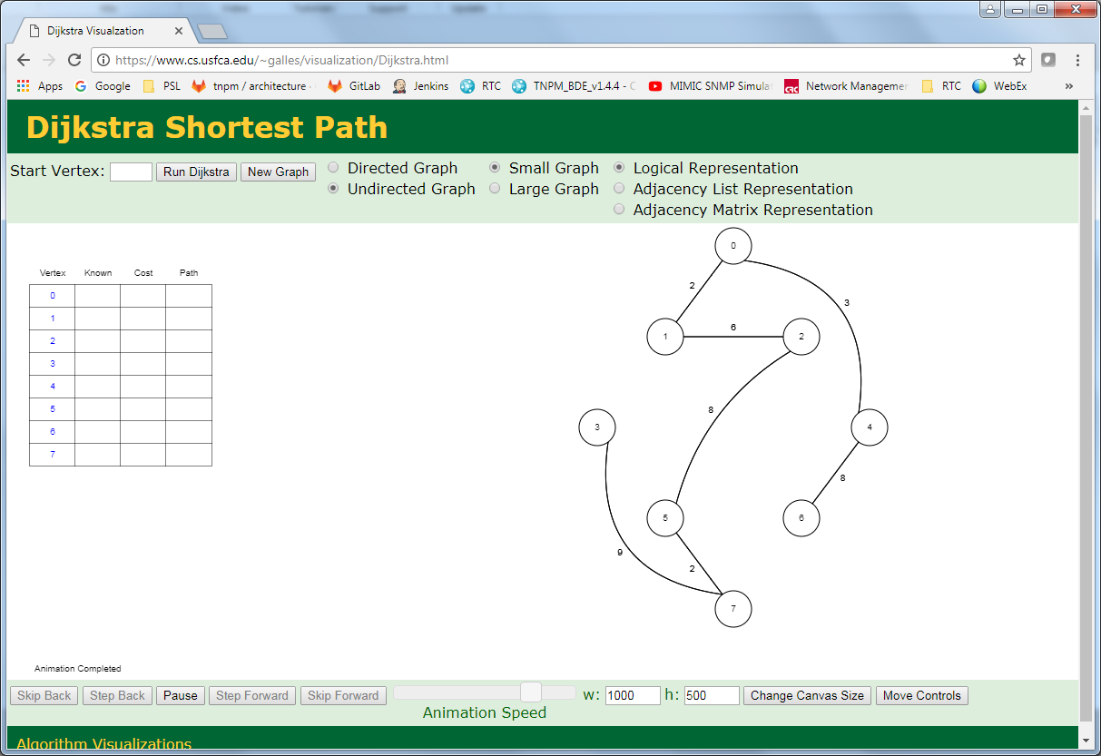
Demo
Notes:
To get this application working, you need to identify the Starting Node then click Run. You don’t specify a destination node, so this implementation will go and find the shortest path from the starting point to every other reachable node.

Slide 12
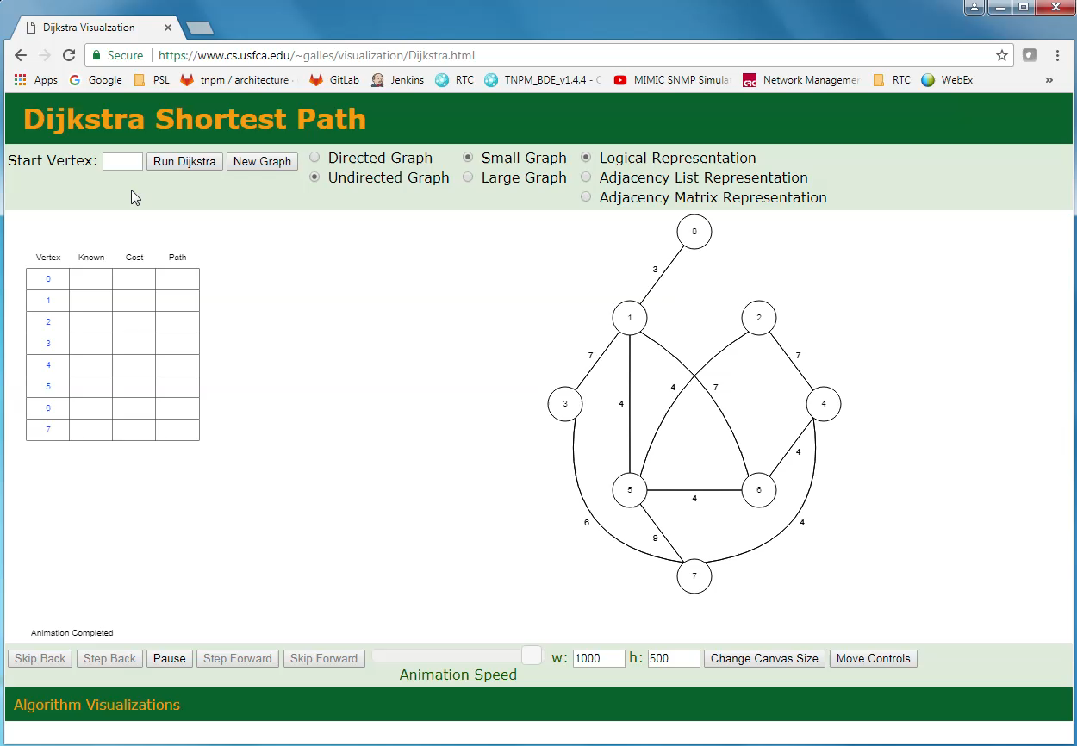
Demo
Notes:
To get this application working, you need to identify the Starting Node then click Run. You don’t specify a destination node, so this implementation will go and find the shortest path from the starting point to every other reachable node.

Slide 13
Assessment
Likes
Dislikes
The animated execution
The tabulated results
Stepping capability
Only operates on randomly generated graphs
Notes:
I like the animated execution and the tabulated results. The ability to step is helpful when trying to closely watch how the algorithm works.

Slide 14
Lisa Velden, Technischen Universität München
Description
A comprehensive learning experience, with exercises
Description of Dijkstra’s algorithm
Interactive graph exploration
https://www-m9.ma.tum.de/graph-algorithms/spp-dijkstra/index_en.html
Notes:
Lisa Velden produced a really nice web application that is a comprehensive learning experience. It provides explanations with visuals and interactive graph exploration.

Slide 15
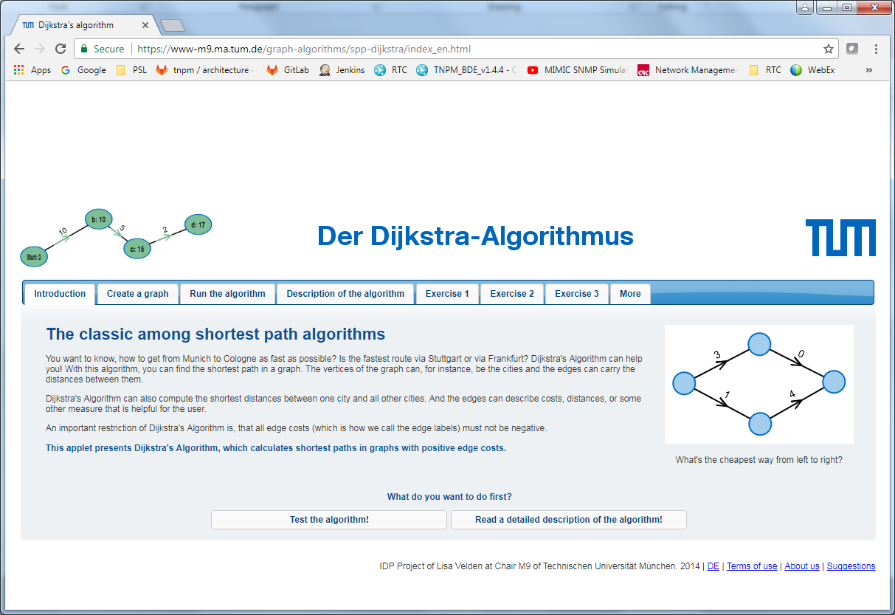
Demo
Notes:
Graph editing is straightforward: you can easily add and remove nodes and edges, and even change existing values. When running, you select the starting node and it finds the shortest path to all connected nodes.

Slide 16
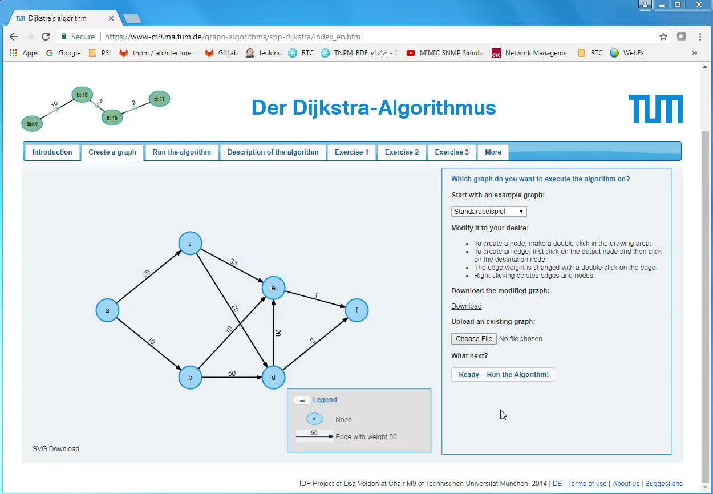
Demo
Notes:
Graph editing is straightforward: you can easily add and remove nodes and edges, and even change existing values. When running, you select the starting node and it finds the shortest path to all connected nodes.

Slide 17
Assessment
Likes
Dislikes
The animated execution
Interactive graph editing
Upload/Download capability
Graph file format
Notes:
The animation here is also very nicely done, as is the graph editing. I also like that you can upload and download graph definitions.

Slide 18
GraphOnline.ru
Description:
An interactive graph editor
With several graph algorithms to choose from
With zoom in/out capability
http://graphonline.ru/en/
Notes:
The last example is Graph Online. The visual elements here are not as pretty as the prior examples – just my opinion. But it has some very nice and features.

Slide 19
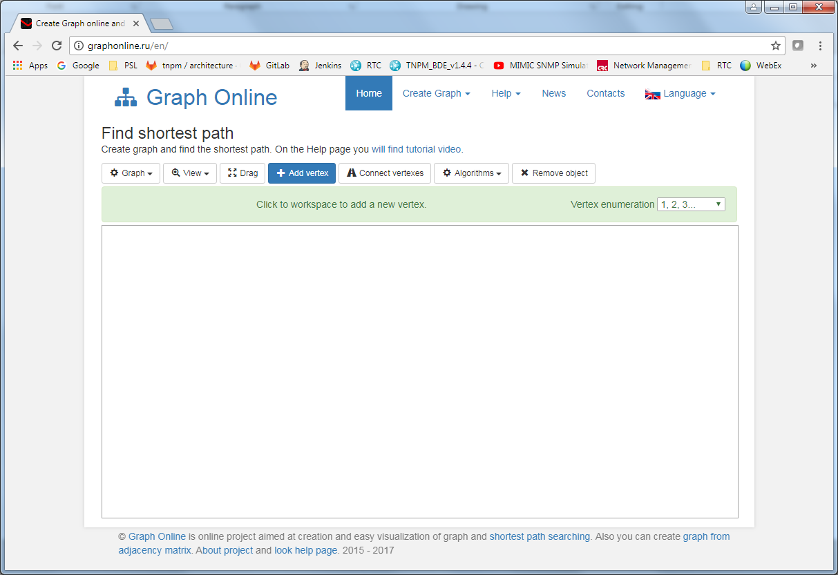
Demo
Notes:
Adding nodes is straightforward in Graph Online. I found adding edges a little “clumsy” but workable. Graph Online provides several algorithms to choose from, and not just those to find the Shortest Path.

Slide 20
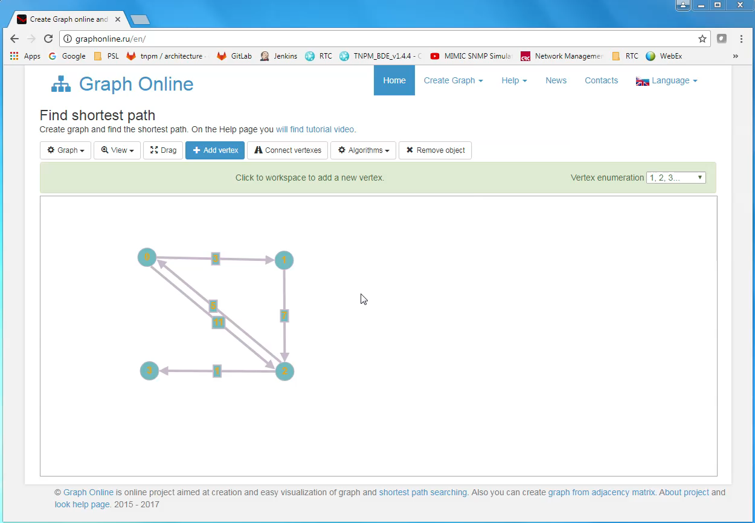
Demo
Notes:
Adding nodes is straightforward in Graph Online. I found adding edges a little “clumsy” but workable. Graph Online provides several algorithms to choose from, and not just those to find the Shortest Path.

Slide 21
Assessment
Likes
Dislikes
Interactive graph editing
Good selection of algorithms
Dijkstra’s
Floyd-Warshall
Find Connected Components
Ability to zoom in/out
Edge editing is “clumsy”
Save is to graphonline.ru web site
No Upload/Download of graph definitions
Notes:
The zoom in and out is a really nice feature, especially if there is a large graph. The selection of algorithms makes this application usable beyond finding shortest path.

Slide 22
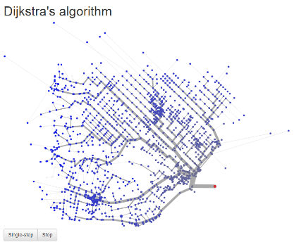
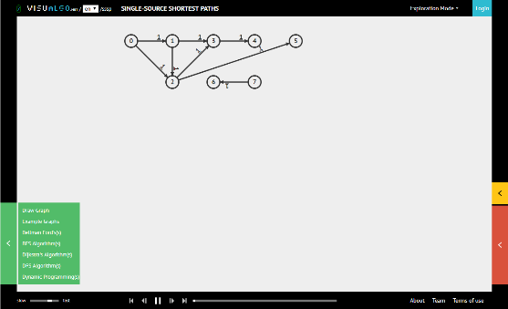
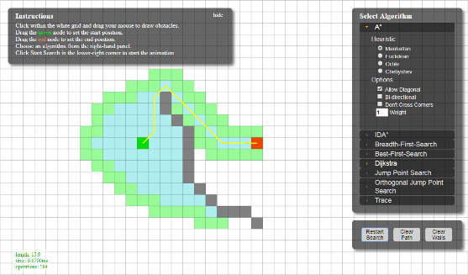
Honorable Mentions
Matthew Wigginton Conway
http://projects.indicatrix.org/dijkstra.js/
VisuAlgo.net
https://visualgo.net/en/sssp
Xueqiao (Joe) Xu, Google
https://qiao.github.io/PathFinding.js/visual/
Notes:
There are so many good resources available online. Conway provides a practical example. There is a graph overlaying a map of Santa Barbara. Select a starting point, and let it run. You can hover over destinations to see the shortest path.

Slide 23
Summary
There are some very good resources on the web
It is easy to derive motivation from existing examples
Some are very well thought out, and showcase very well
None that I explored provided everything that I’m looking for
Notes:
There are some very good resources on the web, and it is easy to derive ideas and motivation. None of the examples provide everything that I was looking for. That’s good, right?

Slide 24
Project Details
Now that we know about Dijkstra’s algorithm
And we have seen some existing visualizations
What did I do here?
Notes:
Now that we know about Dijkstra’s algorithm, and we have seen some existing visualizations … let’s dive into my project work. There’s a lot to get through.

Slide 25
Recall Objectives and Motivation
Explore Dijkstra’s Shortest Path algorithm
Because I needed to dust off my memory of something I learned in undergrad
Visualize Dijkstra’s Shortest Path algorithm
but not just a static visualization, this should be interactive
This will require some exploration first, before jumping into an implementation
Notes:
Most of the motivation for this project comes from my interest in graphs and networks, and how much I have enjoyed learning and working with D3 in this course. But in order to move forward I needed to do some exploration.

Slide 26
Exploring Dijkstra’s Algorithm
Resources
Gilles Bertrand’s Python implementation
http://www.gilles-bertrand.com/2014/03/dijkstra-algorithm-python-example-source-code-shortest-path.html
Finding The Shortest Path, With A Little Help From Dijkstra
https://medium.com/basecs/finding-the-shortest-path-with-a-little-help-from-dijkstra-613149fbdc8e
Dijkstra’s algorithm of finding optimal paths
https://steemit.com/popularscience/@krishtopa/dijkstra-s-algorithm-of-finding-optimal-paths
And of course, Wikipedia
https://en.wikipedia.org/wiki/Dijkstra%27s_algorithm
Notes:
I learned about Dijkstra and shortest path in a class during my undergrad study. I remember implementing the algorithm in Pascal on a VAX mini-computer. I don’t have that old code or old textbook anymore.

Slide 27
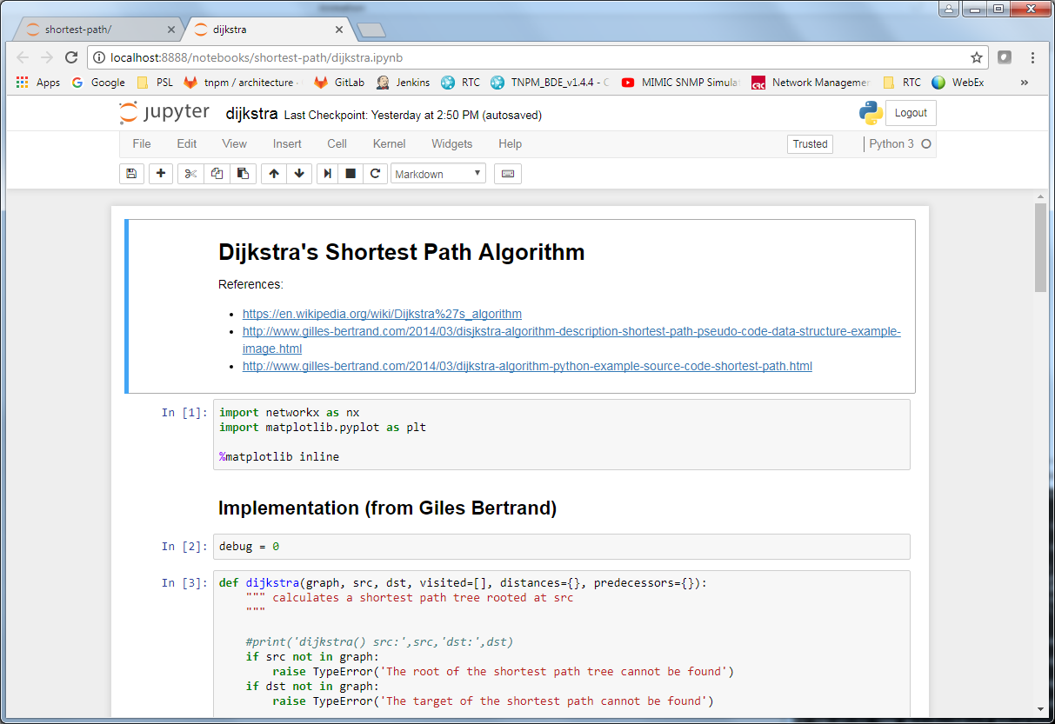
Jupyter Notebook (code)
Notes:
Jupyter Notebook proved again to be a valuable tool. I quickly adapted Gilles Bertrand’s code into the notebook environment, and was on the way to learning and exploration.

Slide 28
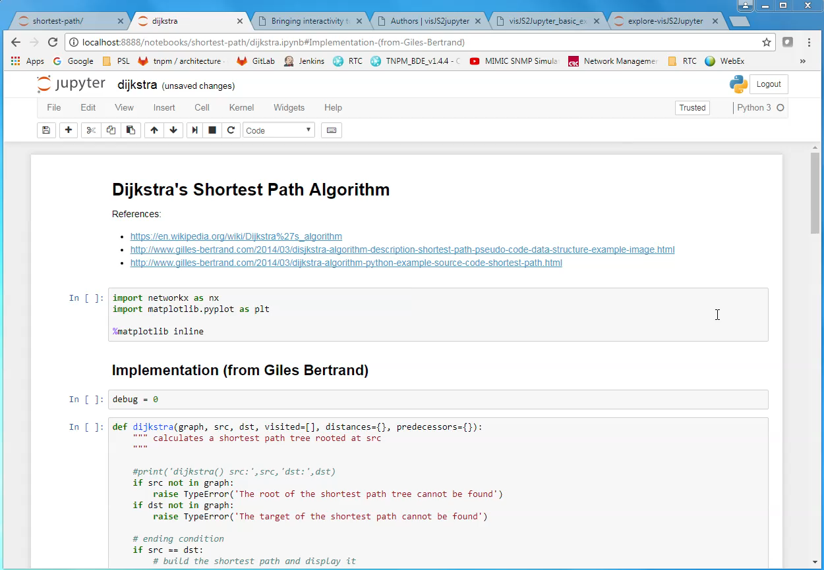
Jupyter Notebook (code)
Notes:
Jupyter Notebook proved again to be a valuable tool. I quickly adapted Gilles Bertrand’s code into the notebook environment, and was on the way to learning and exploration.

Slide 29
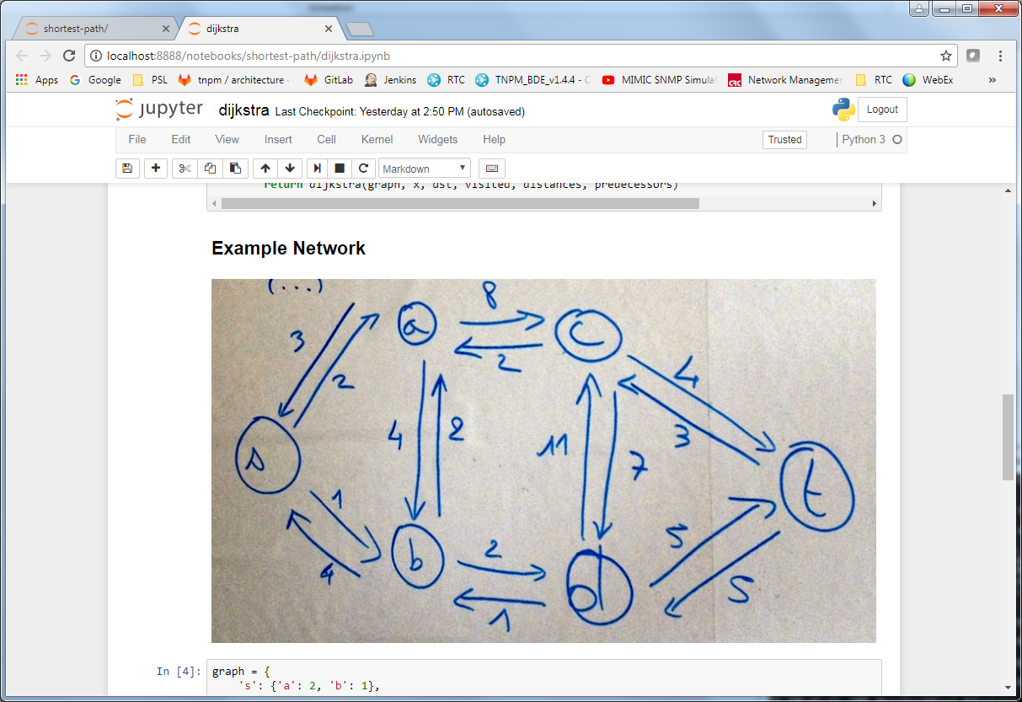
Jupyter Notebook (execution)
Notes:
What I like most about the notebook environment is how rapidly you can develop a small amount of code and how quickly you can see results. It also makes it very easy for using different data sets or modifying an existing data set.

Slide 30
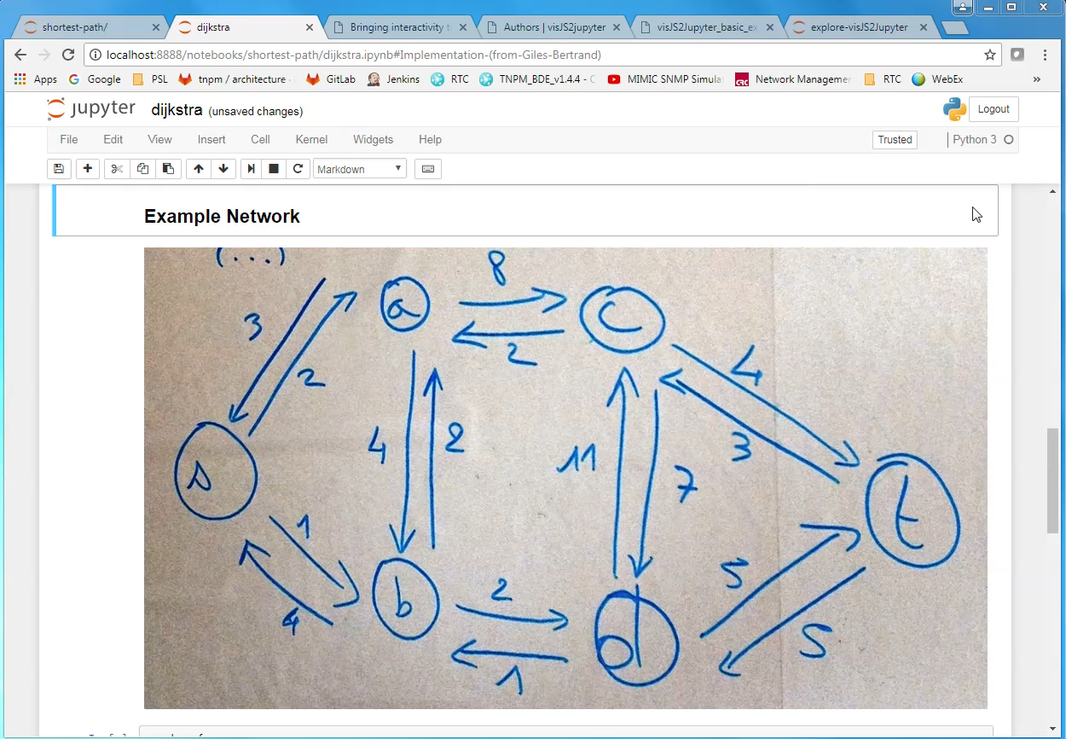
Jupyter Notebook (execution)
Notes:
What I like most about the notebook environment is how rapidly you can develop a small amount of code and how quickly you can see results. It also makes it very easy for using different data sets or modifying an existing data set.

Slide 31
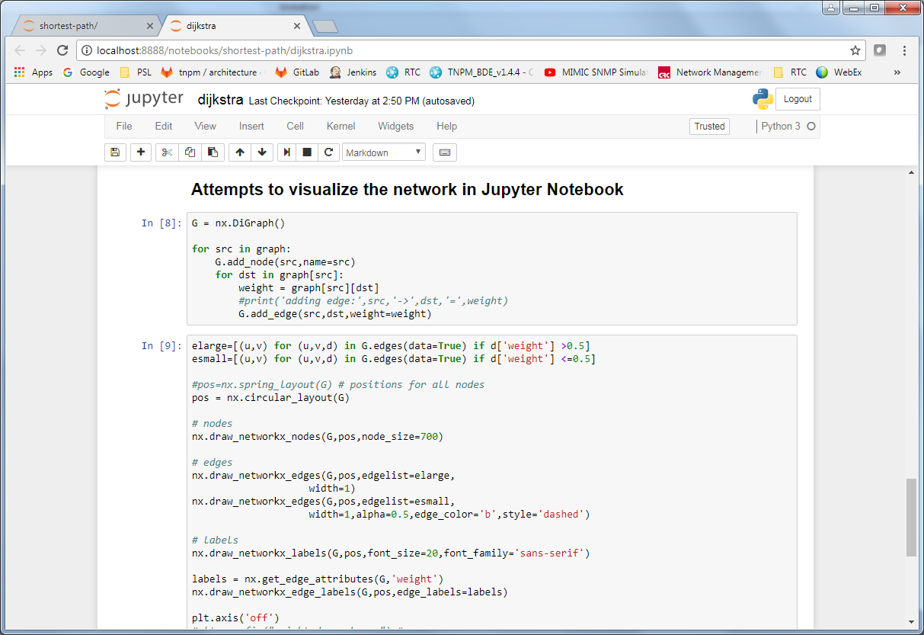
Jupyter Notebook (visualization, try #1)
Notes:
At the outset of this project I envisioned doing everything in the notebook environment first, and then adapting that work into a D3 implementation. However, getting to interactive network visualizations in Jupyter was not easy.

Slide 32
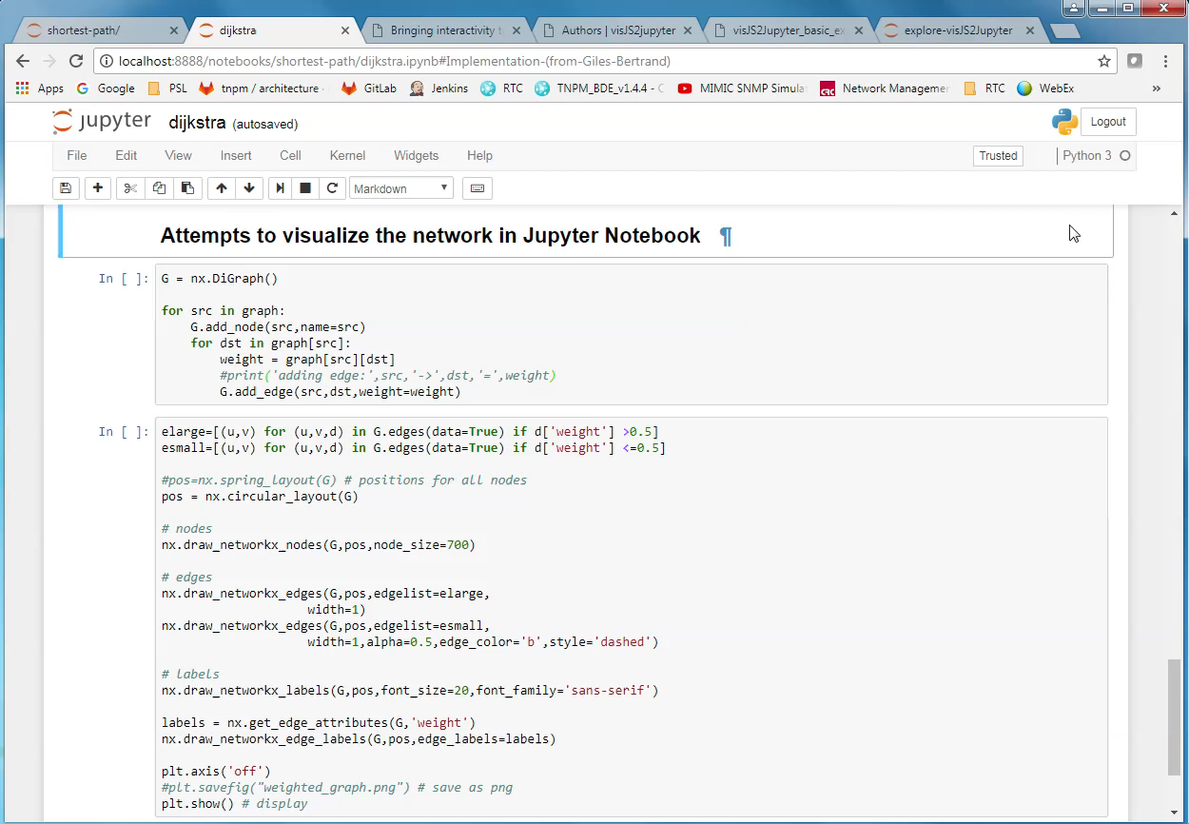
Jupyter Notebook (visualization, try #1)
Notes:
At the outset of this project I envisioned doing everything in the notebook environment first, and then adapting that work into a D3 implementation. However, getting to interactive network visualizations in Jupyter was not easy.

Slide 33
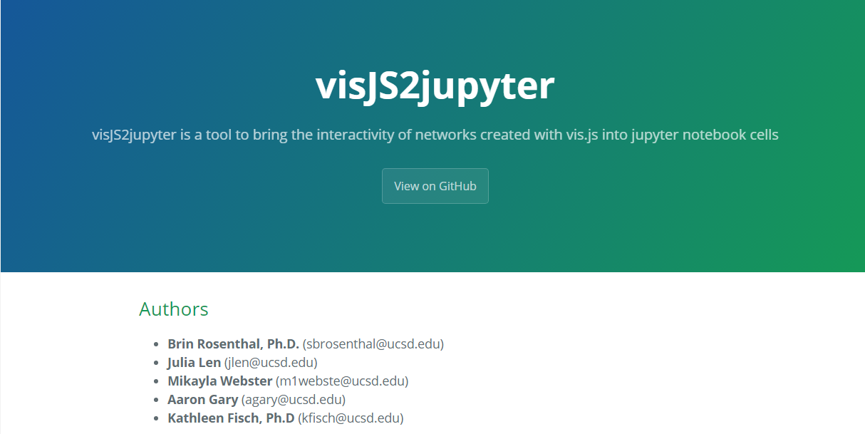
Enter: visJS2jupyter
“a tool to bring the interactivity of networks created with vis.js into jupyter notebook cells”
https://ucsd-ccbb.github.io/visJS2jupyter/
vis.js
A dynamic, browser based visualization library.
Created by a research group at
The Center for Computational Biology & Bioinformatics
Univ. California, San Diego
Notes:
Matplotlib and NetworkX are good at what they do, but they are not quite the solution for interactive network visualizations. Some searching online discovered visJS2jupyter, a really interesting project for network visualization.

Slide 34
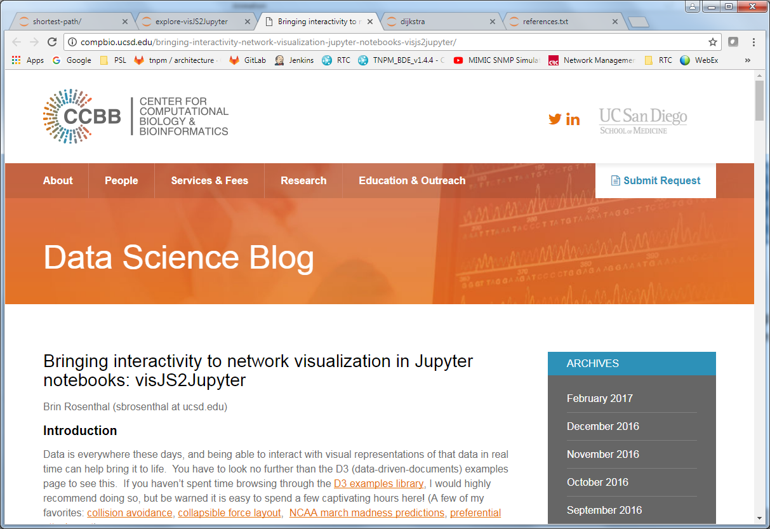
visJS2jupyter (example)
Notes:
The group at UC San Diego wrote a great blog entry on the topic of interactive network visualization in Jupyter. Their use cases are in Biology. This package is mature enough to help me make good progress, and got me much of what I was looking for.

Slide 35
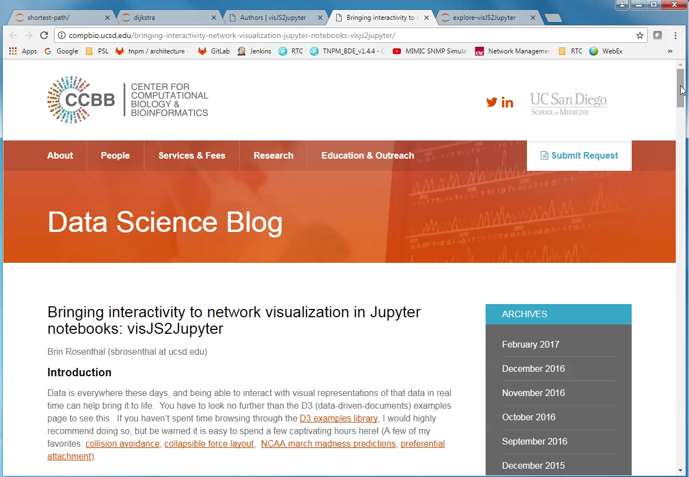
visJS2jupyter (example)
Notes:
The group at UC San Diego wrote a great blog entry on the topic of interactive network visualization in Jupyter. Their use cases are in Biology. This package is mature enough to help me make good progress, and got me much of what I was looking for.

Slide 36
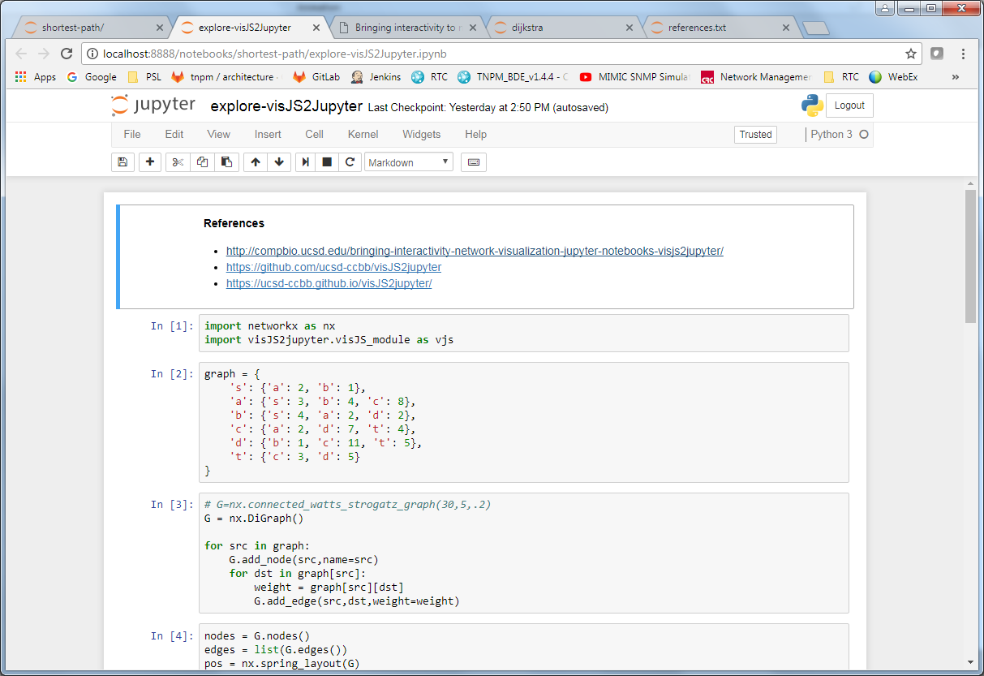
Jupyter Notebook (visualization, try #2)
Notes:
The examples provide the necessary framework for figuring out how the tool works, and you can adapt it for your own needs. They even published some very good documentation. I expect to be looking at this package again in the future.

Slide 37
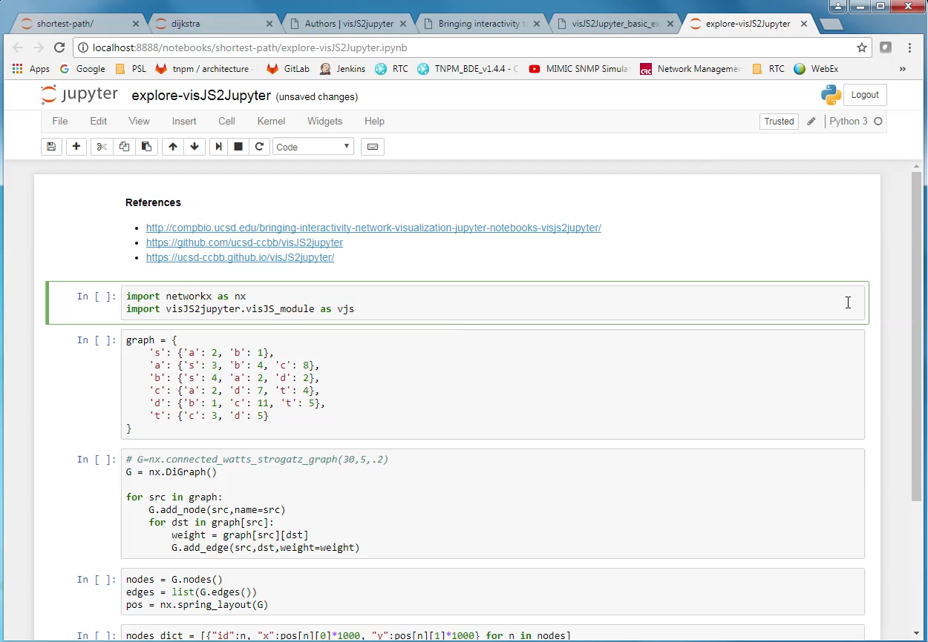
Jupyter Notebook (visualization, try #2)
Notes:
The examples provide the necessary framework for figuring out how the tool works, and you can adapt it for your own needs. They even published some very good documentation. I expect to be looking at this package again in the future.

Slide 38
Exploration – Done!
The Jupyter Notebook exercises helped with
Re-learning Dijkstra’s algorithm
Reading, in depth, some existing code
Stepping through the code with “debug” statements
Exploring some shortest path examples
To reinforce the learning exercises, and solidify understanding
Exploring how to visualize a network
NetworkX + Matplotlib
vis2JSjupyter
Notes:
Learning and exploration in the notebook environment was time well spent. I was able apply this effectively which reinforced my learning and solidified my understanding.

Slide 39
Now, on to more interesting things!
Explore and visualize Dijkstra’s Shortest Path algorithm
undertake a dev-type project
work on something with a lot of interest
Time for a D3.js web application
Notes:
The next stop is building a web application with D3. This is not something that I have a lot of familiarity or experience with, so it still seemed like a hill to climb.

Slide 40
Implementation Objectives
Network described in a file
JSON format
The format used in class is simple and clear
It works seamlessly with D3.js
User Experience
Select file to load
Choose source and destination nodes
Click “Run”
Build this to be extensible, and usable in the future
e.g., in Network Science course (Spring, 2018)
Present more network attributes
Interactively create/modify/save graphs
Notes:
I started with a long wish list of things I wanted to accomplish. Recognizing time constraints, I was able to narrow down this Version 1 to some of the most important items which would make the application usable.

Slide 41
Network JSON Format
{
"nodes": [
{"id": "a", "group": 1},
{"id": "b", "group": 1},
{"id": "c", "group": 1},
{"id": "d", "group": 1},
{"id": "s", "group": 1},
{"id": "t", "group": 1}
],
"links": [
{"source": "s", "target": "a", "value": 2},
{"source": "s", "target": "b", "value": 1},
{"source": "a", "target": "s", "value": 3},
{"source": "a", "target": "b", "value": 4},
{"source": "a", "target": "c", "value": 8},
{"source": "b", "target": "s", "value": 4},
{"source": "b", "target": "a", "value": 2},
{"source": "b", "target": "d", "value": 2},
{"source": "c", "target": "a", "value": 2},
{"source": "c", "target": "d", "value": 7},
{"source": "c", "target": "t", "value": 4},
{"source": "d", "target": "b", "value": 1},
{"source": "d", "target": "c", "value": 11},
{"source": "d", "target": "t", "value": 5},
{"source": "t", "target": "c", "value": 3},
{"source": "t", "target": "d", "value": 5}
]
}
Notes:
Deciding on Data Formats has always seemed important to get right. The Network JSON Format used in class seemed very sufficient, so I opted to go with that.

Slide 42
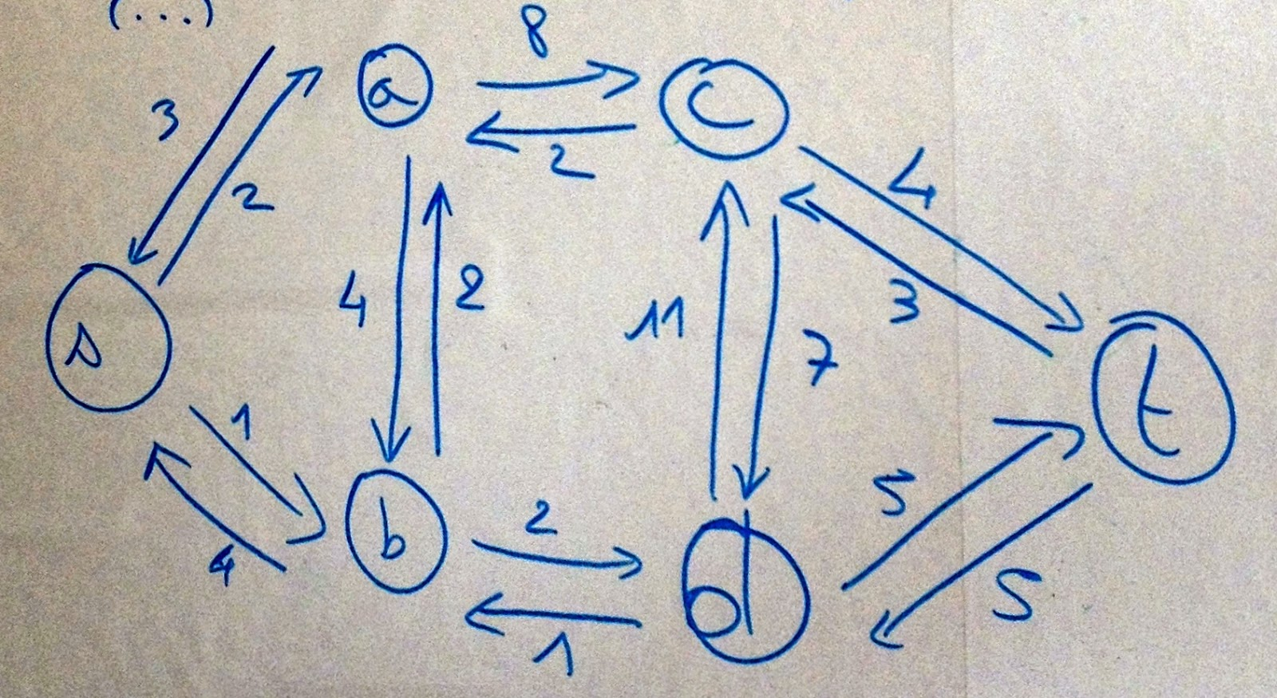
Example Network
Gilles Bertrand example
Find shortest path from ‘s’ to ‘t’
http://www.gilles-bertrand.com/2014/03/disjkstra-algorithm-description-shortest-path-pseudo-code-data-structure-example-image.html
Notes:
The example network used during the notebook exercises was small, simple, and effective. Each pair of connected nodes have directed edges to and from each other.

Slide 43
Coding Dijkstra’s algorithm in JavaScript
Python and JavaScript have similar syntax
Porting Gilles Bertrand’s implementation was straightforward
A few sticking points:
There are some differences in how Array and Dictionary work
JavaScript Array does not have ‘in’ operator
JavaScript Array append is called push()
… and there is corresponding pop(), which permits arrays to work like stacks
Notes:
Gilles Bertrand’s implementation was so straightforward, and the closeness of Python and JavaScript syntax made porting Dijkstra’s algorithm fairly easy.

Slide 44
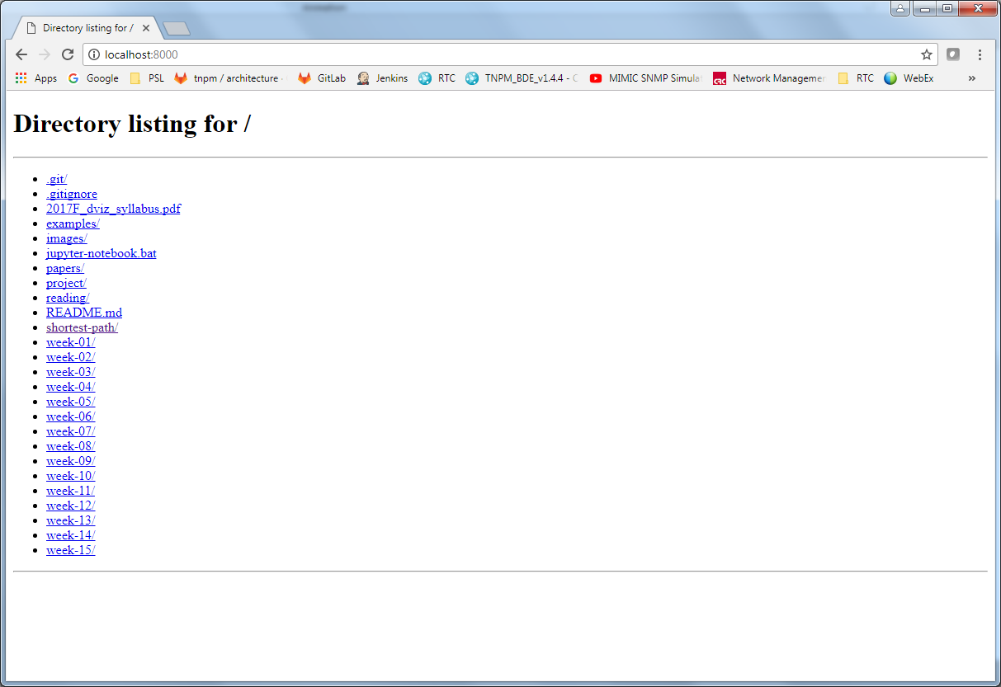
Demo (loading a graph)
Notes:
My D3 web application is pretty simple. That was one of my user experience objectives. It could use some prettying up, eventually. Here we load the network definition from file and use D3 and Force Layout to visualize the network.

Slide 45
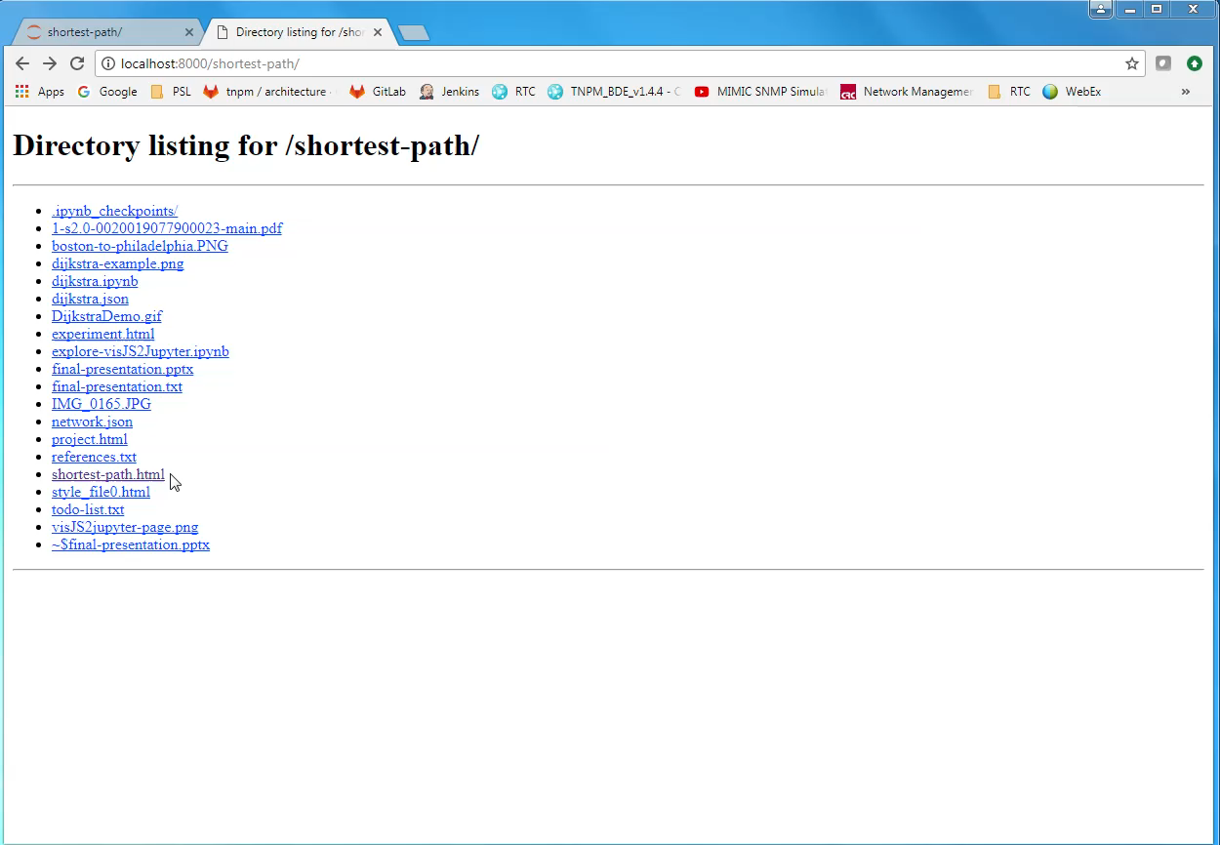
Demo (loading a graph)
Notes:
My D3 web application is pretty simple. That was one of my user experience objectives. It could use some prettying up, eventually. Here we load the network definition from file and use D3 and Force Layout to visualize the network.

Slide 46
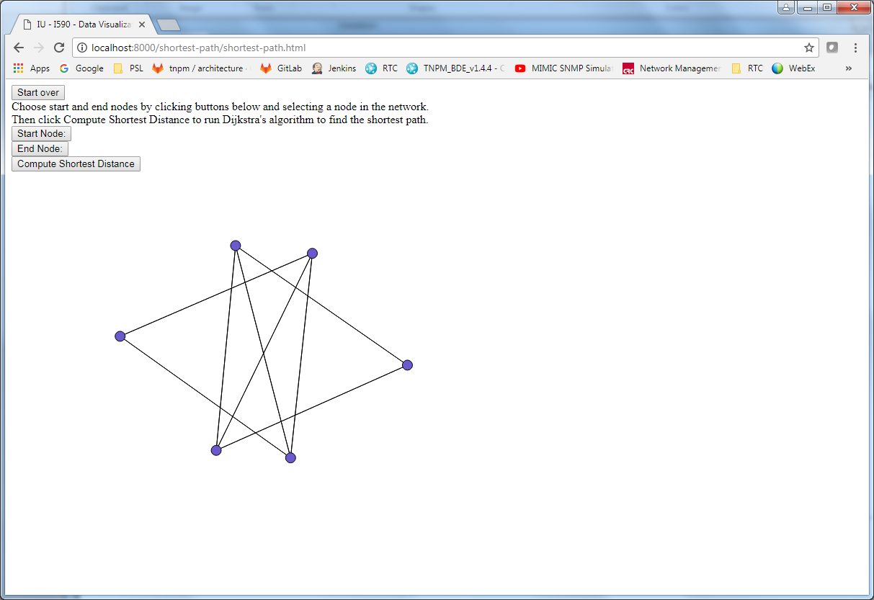
Demo (finding the shortest path)
Notes:
The goal of my application is to find the shortest path between a source and destination node. We select a start node and end node. Click compute and the results are displayed visually and in tabular form.

Slide 47
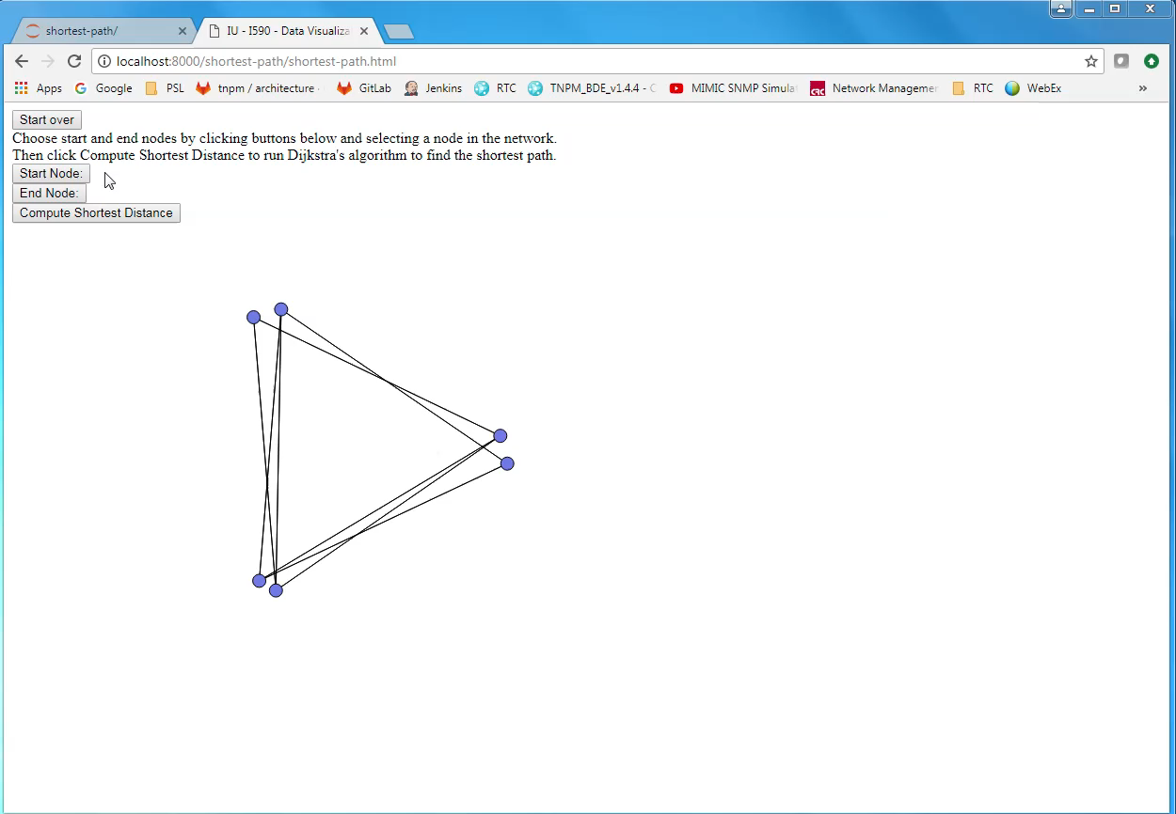
Demo (finding the shortest path)
Notes:
The goal of my application is to find the shortest path between a source and destination node. We select a start node and end node. Click compute and the results are displayed visually and in tabular form.

Slide 48
Lessons Learned
I’m not a web application developer (yet!)
This was my first venture into making any kind of web application
“You don’t know what you don’t know… …until you try something new.”
Jupyter Notebook is awesome!
People are doing all sorts of things with Jupyter
It is not just for summarizing terabytes of data and making bar charts
Notes:
I’m not a web application developer yet! This was a good first project that was not overly simplistic. I learned quite a lot during this process, about JavaScript, D3, and visualizing networks.

Slide 49
What’s Next?
Improve the user experience
Additional capability
Really would like to animate the execution of Dijkstra’s algorithm
This was one of the nicest features of several existing implementations
Make it more resilient
… to invalid user requests
… to “abnormal” network definitions
Notes:
What’s next for my application? I would like to give it a much more complete user experience. And I would like to add more network algorithm capabilities – inspired from some of the examples showcased earlier.

Slide 50

Conclusion
The Data Visualization course material and Lab exercises were very relevant and helpful throughout this project
Several concepts and code were reused
D3 made this project relatively “easy”
D3 provides a lot of capability out of the box
Some things are easy with D3
Some things are not straightforward with D3
There are a lot of D3 resources
d3js.org, bl.ocks.org, Stack Overflow, Twitter, blogs, books
The community is generally very welcoming and helpful
I am optimistic and excited about a future in Data Visualization and Networks with Jupyter and D3.js!
https://en.wikipedia.org/wiki/Gladiator_(2000_film)
Notes:
In closing, I must say this project was a lot of fun and I learned a lot along the way. And, I am really optimistic about my future career in this space. Thank you for watching.

